Slide 1
OOP Concepts

Slide 2
Introduction
OOP stands for Object Oriented Programming

Slide 3
Introduction
Majorly there are FOUR concepts in OOPs

Slide 4
Introduction
1. Encapsulation
2. Abstraction
3. Polymorphism
4. Inheritance

Slide 5
BEFORE… start these concepts
We must know the following
What is an Object?
What is a class?

Slide 6
ENCAPSULATION
Process of combining data and code
Encapsulation = Data + Code
Here Data represents Variables in program
Here Code represents functions in program

Slide 7

ENCAPSULATION
This concept can be implemented using class
Encapsulation = Data + Code
Class = variables + functions
Class is a collection of variables and functions under single unit

Slide 8
ENCAPSULATION
BankAccount
class BankAccount
Attributes
  String name ;
  int accountNumber;
  double balance ;
  String dateOpened;
  String accountType;
  String branch;
{
  String name ;
  int accountNumber;
  double balance ;
  String dateOpened;
  String accountType;
  String branch;
Behavior
  void open( ){….}
  void close( ){….}
  void deposit( ){….}
  void withdraw( ){….}
  void open( ){….}
  void close( ){….}
  void deposit( ){….}
  void withdraw( ){….}
  }

Slide 9
ABSTRACTION
Process of focusing on the essentials, ignoring the irrelevant and unimportant things
Simply abstraction is hiding information which is not required

Slide 10
ABSTRACTION
We use access modifiers to implement this concept
We use keywords like public, private, protected, friend….

Slide 11
ABSTRACTION
private
All the members which are declared under private can be accessed by same class members only. No other class can not access the private members of any other class.

Slide 12
ABSTRACTION
public
All the members which are declared under public, can be accessed by any class members and from any where.

Slide 13
ABSTRACTION
protected
All the members which are declared under protected, can be accessed by same class members and its derived class members.

Slide 14
ABSTRACTION
Modifier
Class
Package
Subclass
World
public
Yes
Yes
Yes
Yes
protected
Yes
Yes
Yes
No
private
Yes
No
No
No
No modifier
Yes
Yes
No
No

Slide 15
Polymorphism in C++
The process of representing one Form in multiple forms is known as Polymorphism.
Here one form represent original form or original method always resides in base class and multiple forms represents overridden method which resides in derived classes.
Polymorphism is derived from 2 Greek words: poly and morphs. The word "poly" means many and morphs means forms. So polymorphism means many forms

Slide 16
Real life example of Polymorphism in C++
Suppose if you are in class room that time you behave like a student, when you are in market at that time you behave like a customer, when you are at your home at that time you behave like a son or daughter, Here one person have different-different behaviors.
Type of Polymorphism •
Polymorphism means more than one function with same name, with different working.
Polymorphism can be static or dynamic.
In static polymorphism memory will be allocated at compile-time.
In dynamic polymorphism memory will be allocated at run-time.
Both function overloading and operator overloading are an examples of static polymorphism.
Virtual function is an example of dynamic polymorphism.
Static polymorphism is also known as early binding and compile-time polymorphism.
Dynamic polymorphism is also known as late binding and run-time polymorphism.

Slide 17
Compile time polymorphism: In this method object is bound to the function call at the compile time itself.
Run time polymorphism: In this method object is bound to the function call only at the run time.
In C++ programming you can achieve compile time polymorphism in two way, which is given below.
• Method Overloading
• Method Overriding

Slide 18
Method Overloading in C++
• Whenever same method name is exiting multiple times in the same class with different number of parameter or different order of parameters or different types of parameters is known as method overloading. In next example method "sum()" is present in Addition class with same name but with different signature or arguments.

Slide 19
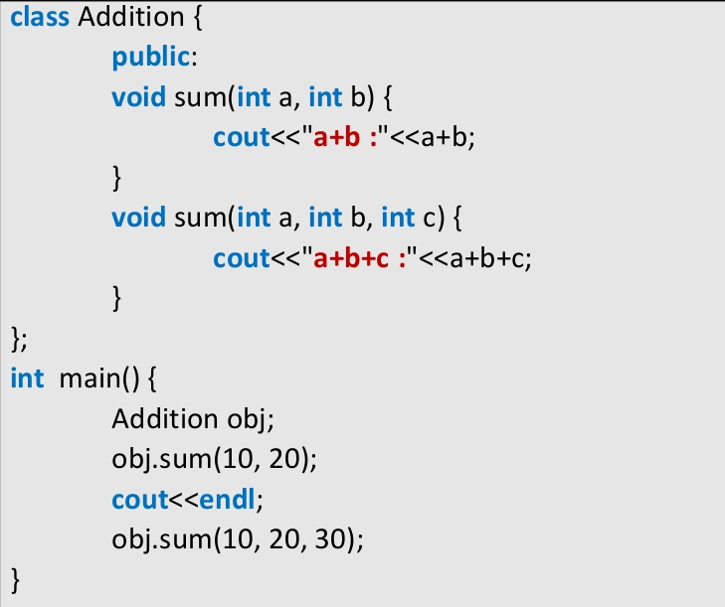
Function Overloading Example
Both Function has same name with different parameter list in same class

Slide 20
C++ Inheritance
One of the most important concepts in object-oriented programming is that of inheritance. Inheritance allows us to define a class in terms of another class, which makes it easier to create and maintain an application. This also provides an opportunity to reuse the code functionality and fast implementation time.
When creating a class, instead of writing completely new data members and member functions, the programmer can designate that the new class should inherit the members of an existing class. This existing class is called the base class, and the new class is referred to as the derived class.

Slide 21
C++ Inheritance
Inheritance is the process by which new classes called derived classes are created from existing classes called base classes.
The derived classes have all the features of the base class and the programmer can choose to add new features specific to the newly created derived class.

Slide 22
C++ Inheritance
Features or Advantages of Inheritance:
Reusability:
Inheritance helps the code to be reused in many situations.
The base class is defined and once it is compiled, it need not be reworked.
Using the concept of inheritance, the programmer can create as many derived classes from the base class as needed while adding specific features to each derived class as needed.

Slide 23
C++ Inheritance
Features or Advantages of Inheritance:
Saves Time and Effort:
The above concept of reusability achieved by inheritance saves the programmer time and effort. The main code written can be reused in various situations as needed.
Increases Program Structure which results in greater reliability.

Slide 24
C++ Inheritance
General Format for implementing the concept of Inheritance:
class derived_classname: access specifier baseclassname
For example, if the base class is MyClass and the derived class is sample it is specified as:
class sample: public MyClass
The above makes sample have access to both public and protected variables of base class MyClass

Slide 25
C++ Inheritance
Reminder about public, private and protected access specifiers:
1 If a member or variables defined in a class is private, then they are accessible by members of the same class only and cannot be accessed from outside the class.
2 Public members and variables are accessible from outside the class.
3 Protected access specifier is a stage between private and public. If a member functions or variables defined in a class are protected, then they cannot be accessed from outside the class but can be accessed from the derived class.

Slide 26
Type of Inheritance
When deriving a class from a base class, the base class may be inherited through public, protected or private inheritance. The type of inheritance is specified by the access- specifier.
We hardly use protected or private inheritance, but public inheritance is commonly used. While using different type of inheritance, following rules are applied:

Slide 27
Type of Inheritance
Public Inheritance: When deriving a class from a public base class, public members of the base class become public members of the derived class and protected members of the base class become protected members of the derived class. A base class's private members are never accessible directly from a derived class, but can be accessed through calls to the public and protected members of the base class.

Slide 28
Type of Inheritance
Protected Inheritance: When deriving from a protected base class, public and protected members of the base class become protected members of the derived class.
Private Inheritance: When deriving from a private base class, public and protected members of the base class become private members of the derived class

Slide 29
C++ Inheritance
Inheritance Example:
class MyClass
{ public:
MyClass(void) { x=0; }
void f(int n1)
{ x= n1*5;}
void output(void) { cout<<x; }
private:
int x;
};

Slide 30
C++ Inheritance
Inheritance Example:
class sample: public MyClass
{ public:
sample(void) { s1=0; }
void f1(int n1)
{ s1=n1*10;}
void output(void)
{ MyClass::output(); cout << s1; }
private:
int s1;
};

Slide 31
C++ Inheritance
Inheritance Example:
int main(void)
{ sample s;
s.f(10);
s.output();
s.f1(20);
s.output();
}
The output of the above program is
50
200

Slide 32


Types of Inheritance
1. Single class Inheritance:
Single inheritance is the one where you have a single base class and a single derived class.
It is a Base class (super)
it is a sub class (derived)

Slide 33






Types of Inheritance
2. Multilevel Inheritance:
In Multi level inheritance, a class inherits its properties from another derived class.
it is a Base class(super) of B
it is a sub class (derived) of A
and base class of class C
derived class(sub) of class B

Slide 34
Types of Inheritance
3. Multiple Inheritances:
In Multiple inheritances, a derived class inherits from multiple base classes. It has properties of both the base classes.
Class A
Class B
Base class
Class C
Derived class

Slide 35


Types of Inheritance
4. Hierarchical Inheritance:
In hierarchical Inheritance, it's like an inverted tree. So multiple classes inherit from a single base class. It's quite analogous to the File system in a unix based system.
Class A
Class B
Class D
Class C

Slide 36
Types of Inheritance
5. Hybrid Inheritance:
In this type of inheritance, we can have mixture of number of inheritances but this can generate an error of using same name function from no of classes, which will bother the compiler to how to use the functions.
Therefore, it will generate errors in the program. This has known as ambiguity or duplicity.
Ambiguity problem can be solved by using virtual base classes

Slide 37
Types of Inheritance
5. Hybrid Inheritance:
Class A
Class B
Class C
Class D

Slide 38
CONSTRUCTORS & DISTRUCTORS
A class constructor is a special member function of a class that is executed whenever we create new objects of that class.
A constructor will have exact same name as the class and it does not have any return type at all, not even void.
Constructors can be very useful for setting initial values for certain member variables.

Slide 39
Example of constructor
#include <iostream>
using namespace std; class Line
{
public:
void setLength( double len );
double getLength( void );
Line(); // This is the constructor
private:
double length;
};
// Member functions definitions including constructor// Line::Line(void)
{
cout << "Object is being created" << endl; }
void Line::setLength( double len )
{
length = len;
}
double Line::getLength( void )
{
return length;
}
// Main function for the program
int main()
{
Line line; // set line length line.setLength(6.0);
cout << "Length of line : " << line.getLength() <<endl;
return 0;
}

Slide 40
Destructor
A destructor is a special member function of a class that is executed whenever an object of it's class goes out of scope or whenever the delete expression is applied to a pointer to the object of that class.
A destructor will have exact same name as the class prefixed with a tilde (~) and it can neither return a value nor can it take any parameters. Destructor can be very useful for releasing resources before coming out of the program like closing files, releasing memories etc.

Slide 41
#include <iostream>
using namespace std;
class Line
{
public:
void setLength( double len );
double getLength( void );
Line(); // This is the constructor declaration
~Line(); // This is the destructor: declaration
private:
double length;
};
// Member functions definitions including constructor Line::Line(void)
{ cout << "Object is being created" << endl; }
Line::~Line(void)
{ cout << "Object is being deleted" << endl; }
void Line::setLength( double len ) { length = len; }
double Line::getLength( void ) { return length; }

Slide 42
Friend class and function IN C++
A friend class can access private and protected members of other class in which it is declared as friend. It is sometimes useful to allow a particular class to access private members of other class.
For example a LinkedList class may be allowed to access private members of Node.
class Node
{
private:
int key;
Node* next;
/* Other members of Node Class */
// Now class LinkedList can access private members of Node
friend class LinkedList;
};

Slide 43
Friend Function
Like friend class, a friend function can be given special grant to access private and protected members. A friend function can be:
a) A method of another class b) A global function
class Node
{
private:
int key;
float next;
/* Other members of Node Class */
friend int LinkedList::search();
// Only search() of linkedList can access internal members
};

Slide 44
Some important points about friend functions and classes
Following are some important points about friend functions and classes:
1) Friends should be used only for limited purpose. too many functions or external classes are declared as friends of a class with protected or private data, it lessens the value of encapsulation of separate classes in object-oriented programming.
2) Friendship is not mutual. If class A is a friend of B, then B doesn’t become a friend of A automatically.
3) Friendship is not inherited

Slide 45
EXAMPLE friend Class
#include <iostream>
class A {
private:
int a;
public:
A() { a = 0; }
friend class B; // Friend Class
};
class B {
private:
int b;
public:
void showA(A& x)
{
// Since B is friend of A, it can access
// private members of A
std::cout << "A::a=" << x.a;
}
};
int main()
{
A a;
B b;
b.showA(a);
return 0;
}
Output:
A::a=0

Slide 46
#include <iostream>
using namespace std;
class Box
{
double width;
public:
friend void printWidth( Box box );
void setWidth( double wid );
};
int main()
{
Box box;
// set box width without member function box.setWidth(10.0);
// Use friend function to print the wdith. printWidth( box );
return 0;
}
// Member function definition
void Box::setWidth( double wid )
{ width = wid; }
// Note: printWidth() is not a member function of any class.
void printWidth( Box box )
{ /* Because printWidth() is a friend of Box, it can directly access any member of this class */
cout << "Width of box : " << box.width <<endl;
}

Slide 47
In C++ following function declarations cannot be overloaded.
1) Function declarations that differ only in the return type.
#include<iostream>
int foo() {
return 10;
}
char foo() {
return 'a';
}
int main()
{
char x = foo();
getchar();
return 0;
}
2) Member function declarations with the same name and the name parameter-type-list cannot be overloaded if any of them is a static member function declaration.
#include<iostream>
class Test {
static void fun(int i) {}
void fun(int i) {}
};
int main()
{
Test t;
getchar();
return 0;
}

Slide 48
3) Parameter declarations that differ only in a pointer * versus an array [] are equivalent. That is, the array declaration is adjusted to become a pointer declaration.
int fun(int *ptr);
int fun(int ptr[]); // redeclaration of fun(int *ptr)
5) Parameter declarations that differ only in the presence or absence of const and/or volatile are equivalent.
#include<iostream>
#include<stdio.h>
using namespace std;
int f ( int x) {
return x+10;
}
int f ( const int x) {
return x+10;
}
int main() {
getchar();
return 0;
}

Slide 49
OPERATOR OVERLOADING
Operator overloading is an important branch of Polymorphism in C++.
Polymorphism
Compile Time
Runtime
Function Overloading
Operator Overloading
Virtual
Functions

Slide 50

OPERATOR OVERLOADING
In simple words, overloading an operator means assigning additional operation or job to it relative to a specific class (user defined type).
One of C++’s great features is its extensibility, Operator Overloading is major functionality related to extensibility.
In C++, most of operators can be overloaded so that they can perform special operations relative to the classes you create.
For example, + operator can be overloaded to perform an operation of string concatenation along with its pre-defined job of adding two numeric values.
When an operator is overloaded, none of its original meaning will be lost.

Slide 51
OPERATOR OVERLOADING
Consider following piece of code. Considering the + operator is overloaded in such a way with class String that it will concatenate two string objects.
int main()
{
int n1 = 10, n2 = 20, n2;
String s1 = “Chemical”, s2=“Engineering”, s3;
n3 = n1 + n2; s3 = s1 + s2;
// addition
// concatenation
}

Slide 52
OPERATOR OVERLOADING
Operators come in three flavours:
Unary (++, --)
Binary (+, -)
Ternay (?:)
You are free to overload most of the built-in operators, but you cannot create new operators of your own.
Therefore, although you can give your class an increment operator (++), you cannot create a squared operator.
You can overload these operators to do anything you want, but it is a good programming practice for them to make sense.
That means you can have the ++ operator to decrement, but it would make no sense to do so.

Slide 53
OPERATOR OVERLOADING
Operators are overloaded by creating operator functions
An operator function defines the operations that the overloaded operator will perform relative to the class upon which it will work.
An operator function is created using the keyword operator
Operator functions can be either
  Member function of a class or
  Non-member function (Mostly Friend Functions)
The way operator functions are written differs between member and non-member functions.

Slide 54
OPERATOR OVERLOADING
Member Operators Function
A member operator function for binary operators
RetType ClassName::operator#(arg-list)
{
// operations
}
Often, operator functions returns an object of the class they operate on, but ret-type can be any valid type.
The # is a placeholder. When you create an operator function, substitute the operator for the #.

Slide 55
OPERATOR OVERLOADING
Member Operators Function
A member operator function for binary operators
RetType ClassName::operator#(arg-list)
{
// operations
}
For example, if you are overloading the + operator, use operator+
While overloading binary operators using member function, the arg-list will contain one parameter.

Slide 56
OPERATOR OVERLOADING
Member Operators Function
A member operator function for Unary operators
RetType ClassName::operator# ( )
{
// operations
}
While overloading an unary operator, arg-list will be empty

Slide 57
OPERATOR OVERLOADING
Friend Operators Function
A Friend operator function for binary operators
friend RetType operator#(arg-list)
{
// operations
}
While overloading a binary operator using friend function; argument list must take 2 arguments, one of them must be of user defined type.

Slide 58
OPERATOR OVERLOADING
Friend Operators Function
A Friend operator function for Unary operators
friend RetType operator#(ClassName &obj)
{
// operations
}
While overloading a Unary operator using friend function; argument list must have arguments, as reference to the object.

Slide 59

OPERATOR OVERLOADING RULES
You cannot change any operators precedence.
You cannot change syntax to use an operator.
You cannot alter the pre-defined job performed by any operator, that means you cannot overload + operator in such a way to perform subtraction of two integers.
You can overload most of Unary and Binary Operators, but you cannot overload the ternary operator (?:)
Binary as well as Unary operators can be overloaded by both Approaches
  Member Functions Approach
  Friend Function Approach

Slide 60


OVERLOADING UNARY - OPERATOR
#include <iostream>
using namespace std;
class space
{
int x ,y, z;
public:
void getdata(int a, int b, int c);
void display();
void operator-(); //overload unary –
};
void space : : getdata(int a, int b, int c)
{ x=a; y=b; z=c; }
void space : : display()
{ cout<<x<<endl; cout<<y<<endl;
cout<<y<<endl; }
void space : : operator-( )
{ x= -x; y= - y; z= - z; }
int main()
{
space S;
S.getdata(10,-20,30);
cout<<“S :=“<<S.display( )<<endl;
-S; //activate operator-() function
cout<<“S :=“<<S.display( )<<endl;
return 0;
}

Slide 61

OVERLOADING UNARY - OPERATOR
The Program produces the following OUTPUT
S : 10 -20 30
S : -10 20 -30

Slide 62

OVERLOADING BINARY + OPERATOR
#include <iostream>
using namespace std;
class complex
{
float x; float y;
public:
complex() { }
complex(float real,float img)
{ x=real; y=img; }
complex operator+(complex);
void display(void);
};
complex complex :: operator+(complex c)
{
complex temp;
temp.x=x+c.x;
temp.y=y+ c.y;
return (temp);
}
void complex::display()
{ cout<<x<<"+j"<<y<<endl; }

Slide 63

OVERLOADING BINARY + OPERATOR
int main()
{
complex C1,C2,C3;
C1=complex(2.5,3.5);
C2=complex(1.6,2.7);
C3=C1+C2; //Invokes operator function
// C3= C1.operator+(C2)//
cout<<"C1:="<<endl; C1.display();
cout<<"C2:="<<endl; C2.display();
cout<<"C3:="<<endl; C3.display();
return 0;
}
OUTPUT:
C1:= 2.5+j3.5
C2:= 1.6+j2.7
C3:= 4.1+j6.2

Slide 64
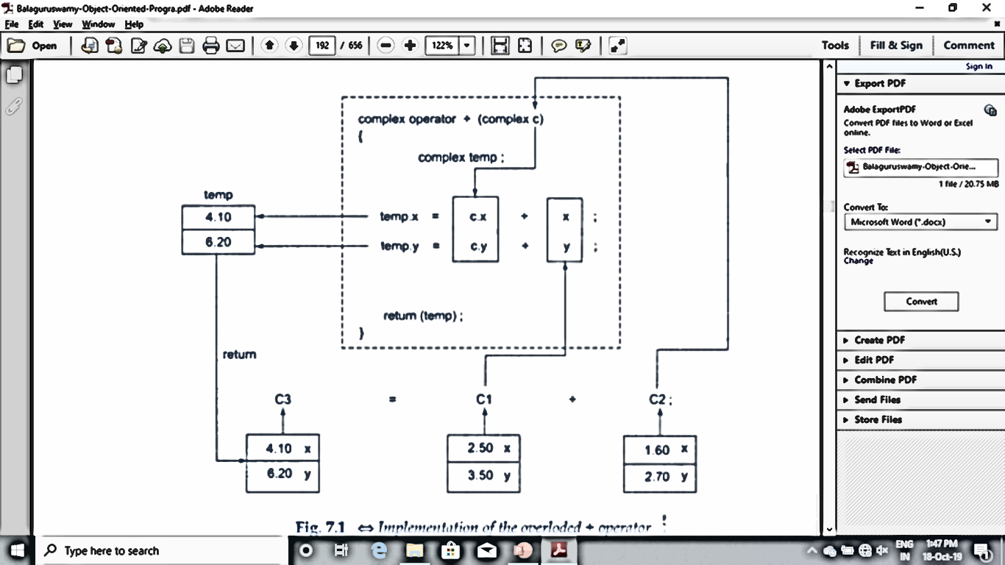
HOW OPERATOR FUNCTION IS INVOKED

Slide 65
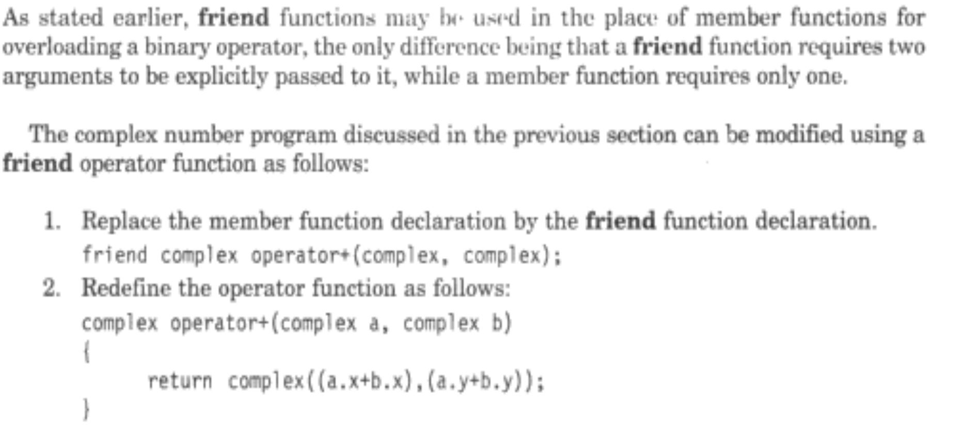
OVERLOADING BINARY + OPERATOR USING FRIEND

Slide 66
CONCATENATE TWO STRINGS BY OVERLOADING BINARY + OPERATOR
#include <iostream>
using namespace std;
class AddString {
public:
char str[100];
AddString() {} // No Parameter Constructor
AddString(char str[]) // Parametrized constructor to initialize class Variable
{ strcpy(this->str, str); }
AddString operator+(AddString& S2) //Overload Operator+ to concatenate strings
{
AddString S3; // Object to return the copy of concatenation
strcat(this->str, S2.str); // Use strcat() to concat two specified string
strcpy(S3.str, this->str); // Copy the string to string to be return
return S3; // return the object
}
};
int main()
{
char str1[] = “Chemical";
char str2[] = “Engineering";
AddString a1(str1);
AddString a2(str2);
AddString a3;
// Call the operator function
a3 = a1 + a2;
cout << "Concatenation: " << a3.str;
return 0;
}

Slide 67
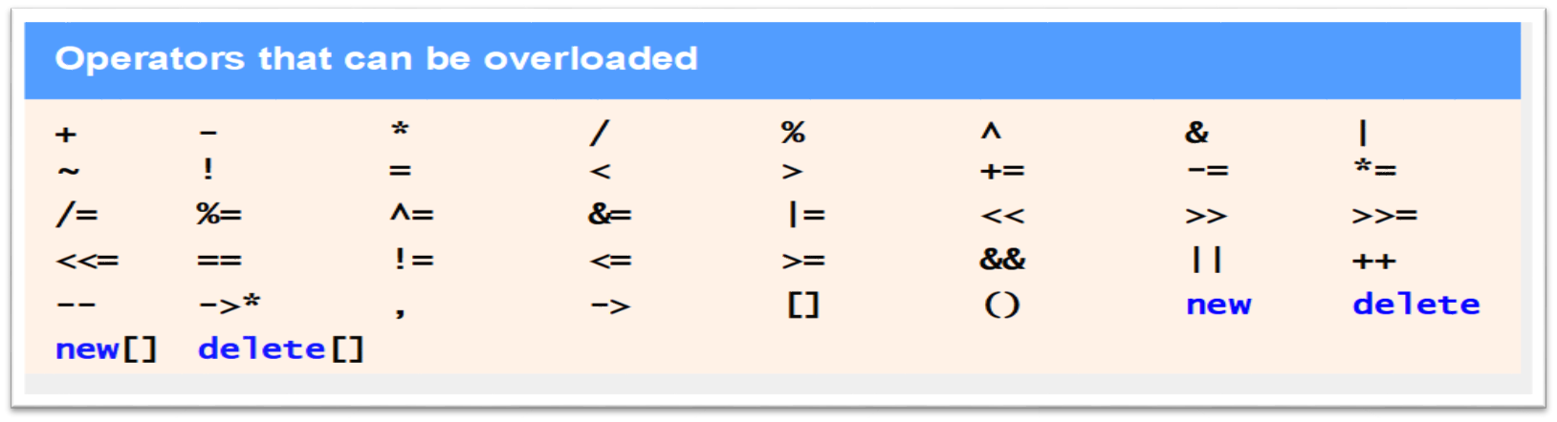
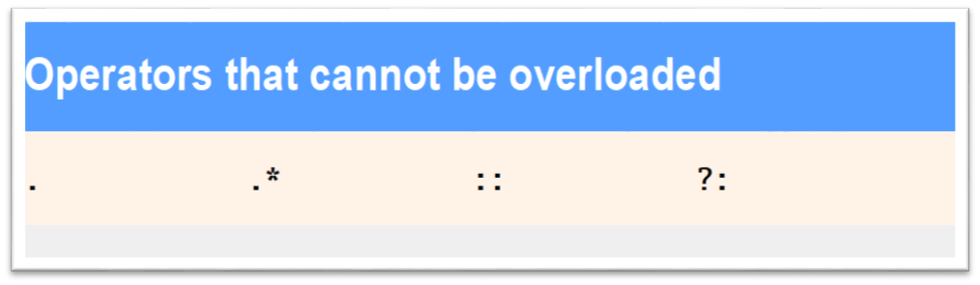
Operators that Can and Cannot be Overloaded

Slide 68
Problem while OVERRIDING a function
Polymorphism refers to the property by which objects belonging to different classes are able to respond to the same message but in different forms.
When there are C++ functions with the same name in both superclass as well as a subclass, virtual functions gives programmer capability to call a member function of a different class by the same function call based upon different context.
This feature is known as polymorphism which is one of the important features of OOP.
Let us discuss the problem that arises in Inheriting a class and what happens when a function is OVERRIDDEN in the derived class.

Slide 69
Problem while OVERRIDING a function
int main()
{
BaseClass base;
base.b=1000;
base.show();
DerivedClass derived;
derived.d=3000;
derived.show();
return 0;
}
OUTPUT
IN THE BASE CLASS
b=1000
IN THE DERIVED CLASS
b=0
d=3000

Slide 70
Problem while OVERRIDING a function
#include<iostream>
using namespace std;
class BaseClass
{
public:
int b;
void show()
{
cout<<"IN THE BASECLASS"<<endl;
cout<<"b="<<b<<endl;
}
};
class DerivedClass : public BaseClass
{
public:
int d;
  void show()
  {
  cout<<"IN THE DERIVED CLASS"<<endl;
  cout<<"b="<<b<<endl;
  cout<<"d="<<d<<endl;
  }
};

Slide 71
Pointer to Derived Class
#include<iostream>
using namespace std;
class BaseClass
{
public:
int b;
void show()
{ cout<<"b="<<b<<endl;
}
};
class DerivedClass : public BaseClass
{
public:
int d;
void show()
{
cout<<"b="<<b<<endl;
cout<<"d="<<d<<endl;
}
};

Slide 72
Pointer to Derived Class
int main()
{
BaseClass *baseptr;
BaseClass base;
baseptr= &base;
//Access base class member via base pointer//
baseptr->b=100;
cout<<"base pointer points to base class OBJECT"<<endl;
baseptr->show();
DerivedClass derived;
baseptr=&derived;
baseptr->b=200;
cout<<"base pointer now points to derived class OBJECT"<<endl;
baseptr->show();
DerivedClass *dc;
dc=&derived;
dc->d=300;
cout<<"derived pointer now points to derived class OBJECT"<<endl;
dc->show();
((DerivedClass*)baseptr)->d=400;
((DerivedClass*)baseptr)->show();
return 0;
}

Slide 73
Pointer to Derived Class
OUTPUT
base pointer points to base class OBJECT
b=100
base pointer now points to derived class OBJECT
b=200
derived pointer now points to derived class OBJECT
b=200
d=300
b=200
d=400
We have used the statement baseptr->show(); two times . First when the baseptr points to the Base class object, and second when the baseptr is made to point to the derived class object.
But both times it called the Base Class show() function and displayed the content of base class object.
This shows that although a base class pointer can be made to point to any number of Derived class objects but it cannot access the members defined in a derived class

Slide 74
Virtual Functions(Dynamic Binding)
A virtual function is a special form of member function that is declared within a base class and redefined by a derived class.
The keyword virtual is used to create a virtual function, precede the function's declaration in the base class.
If a class includes a virtual function and if it gets inherited, the virtual class redefines a virtual function to go with its own need. In other words, a virtual function is a function which gets override in the derived class and instructs the C++ compiler for executing late binding on that function.
A function call is resolved at runtime in late binding and so compiler determines the type of object at runtime.

Slide 75
Virtual Functions
A virtual function a member function which is declared within a base class and is re defined(Overriden) by a derived class.
When you refer to a derived class object using a pointer or a reference to the base class, you can call a virtual function for that object and execute the derived class’s version of the function.
Virtual functions ensure that the correct function is called for an object, regardless of the type of reference (or pointer) used for function call.
They are mainly used to achieve Runtime polymorphism
Functions are declared with a virtual keyword in base class.
The resolving of function call is done at Run-time.

Slide 76
Rules for Virtual Functions
Virtual functions cannot be static and also cannot be a friend function of another class.
Virtual functions should be accessed using pointer or reference of base class type to achieve run time polymorphism.
The prototype of virtual functions should be same in base as well as derived class.
They are always defined in base class and overridden in derived class. It is not mandatory for derived class to override (or re-define the virtual function), in that case base class version of function is used.
A class may have virtual destructor but it cannot have a virtual constructor.

Slide 77
Virtual Functions
// CPP program to illustrate concept of Virtual Functions
#include<iostream>
using namespace std;
class base
{
public:
virtual void print ()
{ cout<< "print base class" <<endl; }
void show ()
{ cout<< "show base class" <<endl; }
};
class derived:public base
{
public:
void print ()
{ cout<< "print derived class" <<endl; }
void show ()
{ cout<< "show derived class" <<endl; }
};

Slide 78
Virtual Functions
int main()
{
base *bptr;
derived d;
bptr = &d;
//virtual function, binded at runtime
bptr->print();
// Non-virtual function, binded at compile time
bptr->show();
}
OUTPUT
Print derived class
Show base class

Slide 79
EXAMPLE VIRTUAL FUNCTION
Class A
{
Public:
void f1(){…..}
virtual f2() {…..}
virtual f3() {…..}
virtual f4() {…..}
}
Class B : public A
{
Public:
void f1() {…..}
void f2() {…..}
void f4(int x) {…..}
}
Int main()
{
A *p;
B obj;
p=&obj;
p-> f1();
    p-> f2();
    p-> f3();
    p-> f4();
    p-> f4(5);
}
//Early Binding
    //late Binding
    //late Binding
    //late Binding
    //Early Binding

Slide 80
Virtual base class in C++
Virtual base classes are used in virtual inheritance in a way of preventing multiple “instances” of a given class appearing in an inheritance hierarchy when using multiple inheritances.
Need for Virtual Base Classes:
Consider the situation where we have one class A .This class is A is inherited by two other classes B and C. Both these class are inherited into another in a new class D as shown in figure below.
As we can see from the figure that data members/function of class A are inherited twice to class D.
One through class B and second through class C.
When any data / function member of class A is accessed by an object of class D, ambiguity arises as to which data/function member would be called? One inherited through B or the other inherited through C.
This confuses compiler and it displays error.

Slide 81
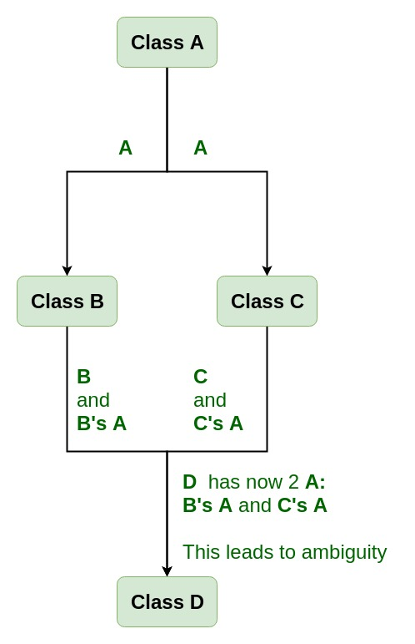
Hirarchial Inheritance
Multiple
Inheritance

Slide 82
HYBRID
Inheritance

Slide 83
EXAMPLE VIRTUAL CLASS
#include <iostream>
using namespace std;
class A
{
public:
void show()
{
cout << "Hello form A \n";
}
};
class B : public A {
};
class C : public A {
};
class D : public B, public C {
};
int main()
{
D object;
object.show();
}
OUTPUT
prog.cpp: In function 'int main()':
prog.cpp:29:9: error: request for member 'show' is ambiguous object.show();
^

Slide 84
How to resolve this issue?
To resolve this ambiguity when class A is inherited in both class B and class C, it is declared as virtual base class by placing a keyword virtual as :
Syntax for Virtual Base Classes:
Syntax 1:
class B : virtual public A
{
};
Syntax 2:
class C : public virtual A
{
};

Slide 85
How to resolve this issue?
#include <iostream>
using namespace std;
class A {
public:
int a;
A() // constructor
{
a = 10;
}
};
class B : public virtual A {
};
class C : public virtual A {
};
class D : public B, public C {
};
int main()
{
D object; // object creation of class d
cout << "a = " << object.a << endl;
return 0;
}
OUTPUT
a=10

Slide 86
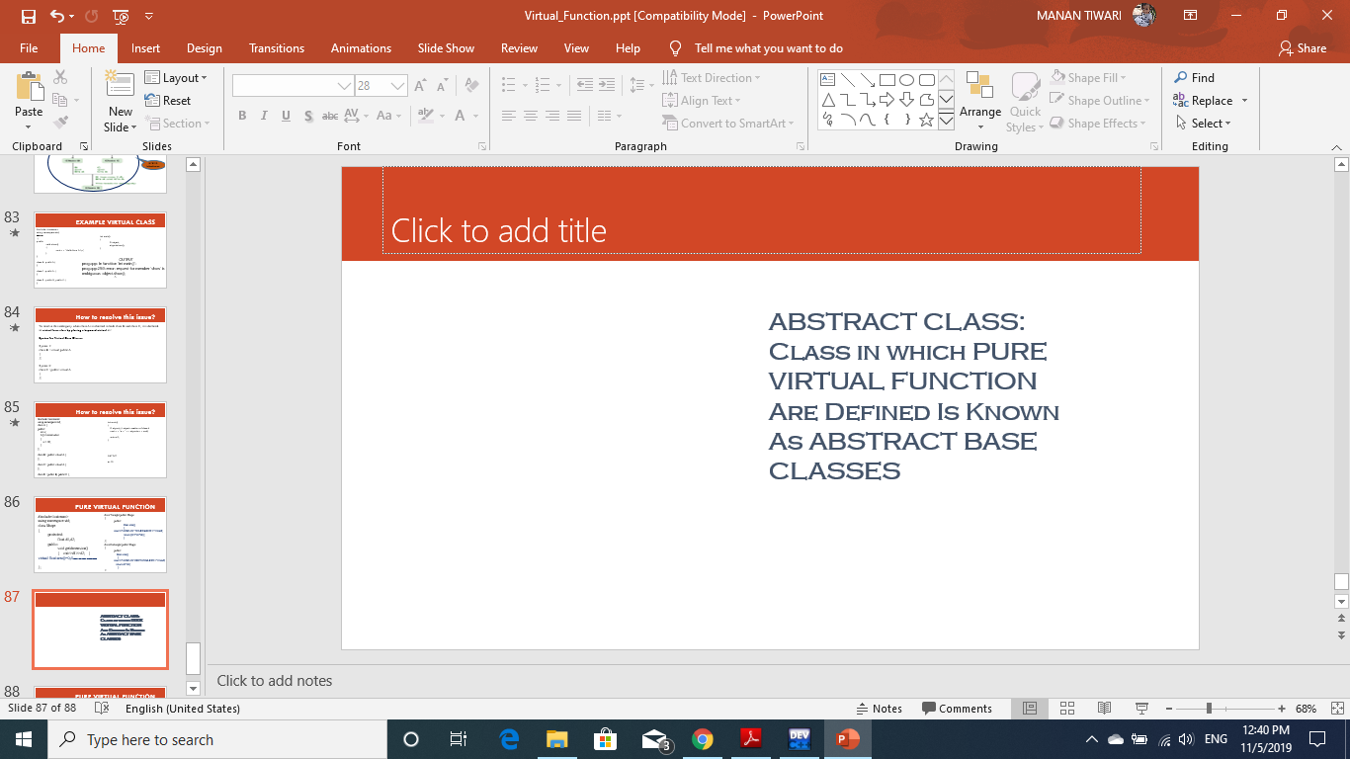
PURE VIRTUAL FUNCTION
#include<iostream>
using namespace std;
class Shape
{
protected:
float d1,d2;
public:
void getdimension()
{ cin>>d1>>d2; }
virtual float area()=0;//PURE VIRTUAL FUNCTION
};
class Traingle:public Shape
{
public:
float area()
{
cout<<"AREA OF TRAINGLE IS:="<<endl;
return (0.5*d1*d2);
}
};
class Rectangle:public Shape
{
public:
float area()
{
cout<<"AREA OF RECTANGLE IS:="<<endl;
return d1*d2;
}
};

Slide 87
PURE VIRTUAL FUNCTION
int main()
{ //Shape s;// this will give error
Traingle t;
cout<<"ENTER TRIANGLE BASE AND HEIGHT"<<endl;
t.getdimension();
cout<<"AREA="<<t.area()<<endl;
Rectangle r;
cout<<"ENTER Rectangle BASE AND HEIGHT"<<endl;
r.getdimension();
cout<<"AREA="<<r.area()<<endl;
return 0;
}

